Slide 1
Datasets
Brief description of dataset and steps to extract/donwload

Slide 2
Datasource
Satellite | Bands | Time Slices
Sentinel-2-L2A | 10m/pixel:AOT,B02,B03,B04,B08,WVP,visual 20m/pixel:B05,B06,B07,B11,B12,B8A,SCL 60m/pixel: B01,B09 | Selected based on the lowest cloud cover throughout 2022 Time Slices: '2021-02-19/2021-02-20', '2021-02-09/2021-02-10', "2021-03-01/2021-03-02", "2021-03-11/2021-03-12", "2021-03-21/2021-03-22", "2021-03-31/2021-04-01", '2021-08-28/2021-08-29', '2021-08-18/2021-08-19', '2021-08-08/2021-08-09', '2021-12-26/2021-12-27', '2021-12-16/2021-12-17', '2021-12-06/2021-12-07'

Slide 3
Datasource
Satellite | Bands | Time Slices
Sentinel-1-RTC | 10m/pixels: vv,vh | Selected based on the closest to dates chosen for Sentinel-2 Time slices: Sentinel-1A '2021-01-15', '2021-02-19', '2021-03-04', '2021-03-28', '2021-08-18', '2021-12-05', '2021-12-29’, Sentinel-1B '2021-03-21', '2021-03-09', '2021-05-20', '2021-06-01'

Slide 4
Methodology
Cluster data points by locations
Training & Inference data location investigation
Download data to NetCDF file
Download Sentinel-2 data (lowest cloud cover in 2022)
Download Sentinel-1 data (nearest corresponding dates with Sentinel-2 Data)
Extract data (from downloaded NetCDF)
Get pixel values (data at the location stated in csv file)
Get windows of pixels values (data at the location and the surrounding square area)
Save table/dataframe as pickle and excel for ease of further use

Slide 5
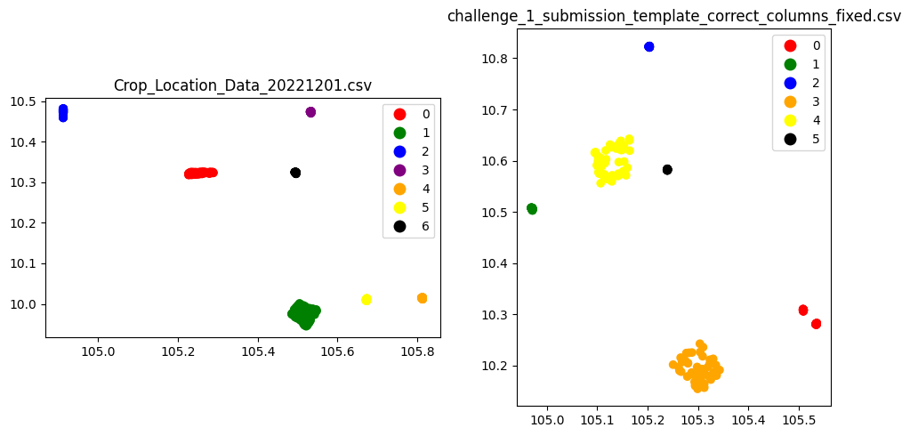
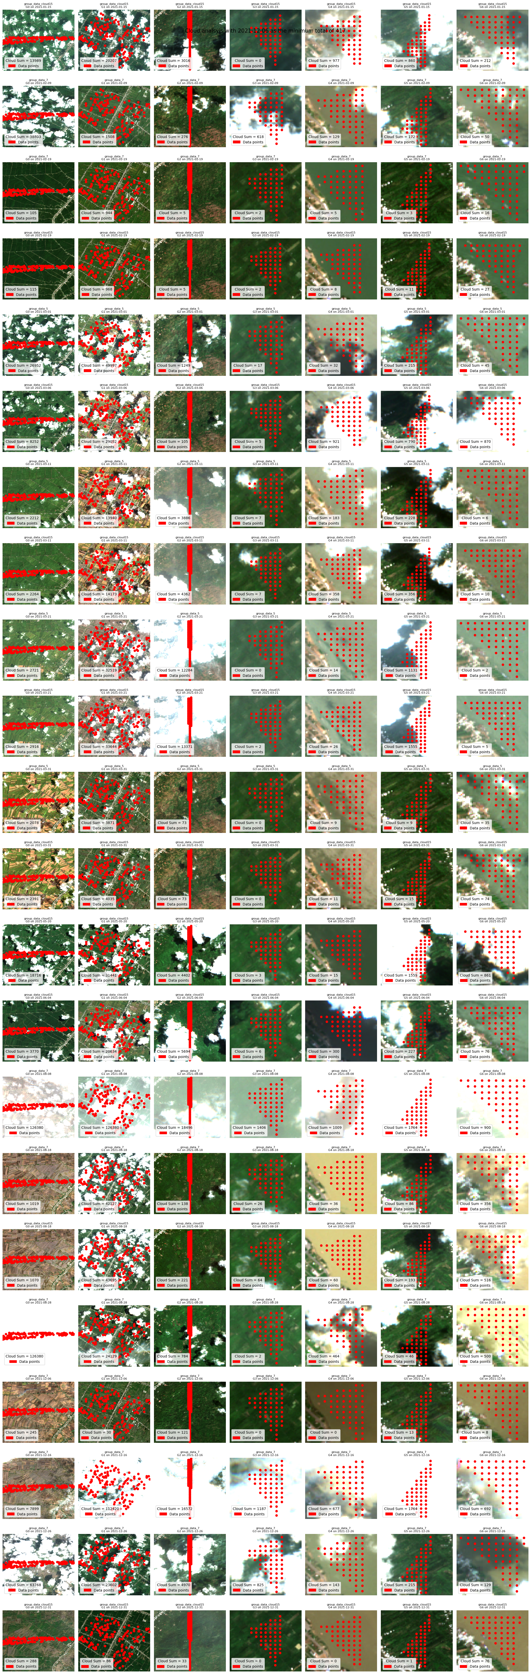
1. Cluster data points by locations
Data point were grouped into clusters to allow downloading smaller bounding box areas.
To save disk space.
To allows faster downloading time.
To avoid "One" big download that may cause "One" big failed download if network fail.
“Inference data”
Example of downloaded
Training Data on 19 Feb 2022
“Training data”

Slide 6
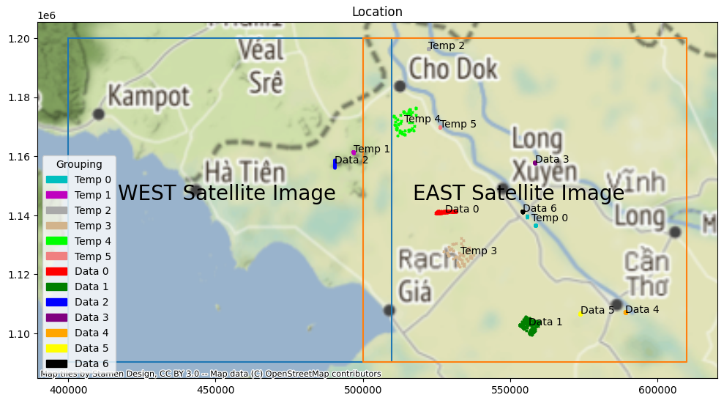
2. Investigate training & inference data
Data need to be obtained from two separate scenes to completely cover all the needed data
I.e. “Data 2” & “Temp 1” are on the west scenes while the others are on the east.
Sentinel-2 West scenes boundary
Sentinel-2 East scenes boundary
* This slide is to justify why the code finds items for “west” & “east”
** “Scenes” are called “items” in pystac API. Therefore sometimes used interchangeably

Slide 7
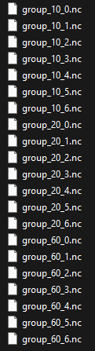
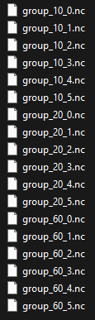
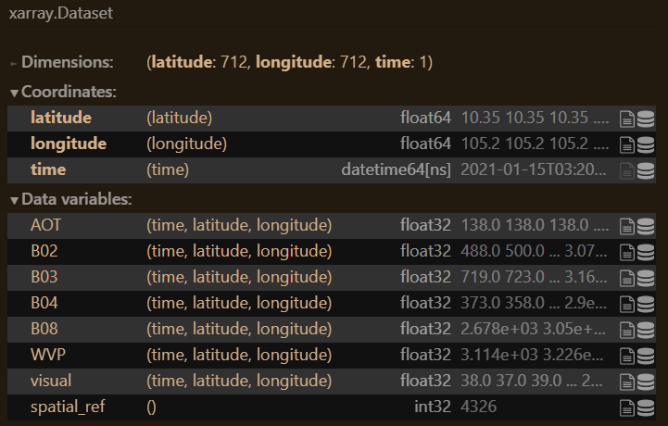
3. Download data to NetCDF file
The downloaded data are xarray.Dataset objects
Data are downloaded by their respective spatial resolution as follows:
Sentinel-2-L2A
10m/pixel: AOT,B02,B03,B04,B08,WVP,visual
20m/pixel: B05,B06,B07,B11,B12,B8A,SCL
60m/pixel: B01,B09
Sentinel-1-RTC
10m/pixel: vv,vh
File naming convention
group_<resolution>_<group>.nc
Group 0-6*
Training Data
Group 0-5*
Inference Data
Example xarray.Dataset
for group_10_0.nc
* Grouping is based on the clusters established before

Slide 8
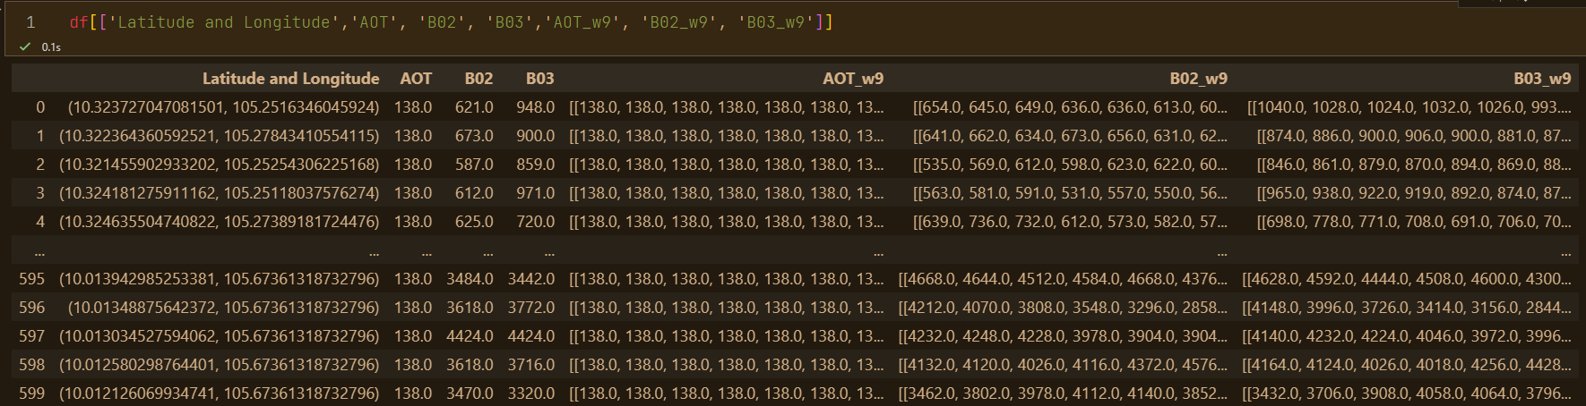
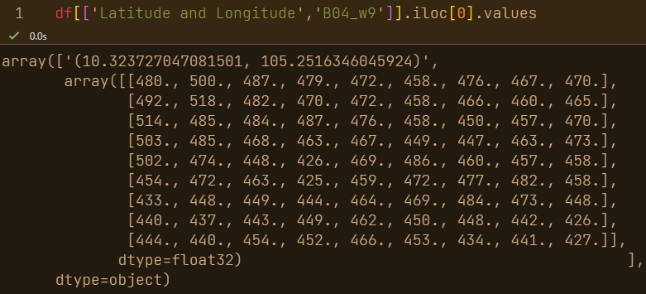
4. Extract data (from downloaded NetCDF) and save to pickle and excel*
xarray.Dataset
Saved as NetCDF
Extract
Pandas DataFrame
saved as pickle
Pixel Values (Sentinel-2 16 columns, Sentinel-1 2 columns):
Each column of the dataframe represent 1 pixel at the location
Eg. AOT,B02,B03
Window of Pixels Values (Sentinel-2 16 columns, Sentinel-1 2 columns):
Each column of the dataframe represent 9x9 pixels at the location as the center
Eg. B04
* Sample data outputs are attached as excel

Slide 9
Challenges
Unfamiliarity with the data source (i.e. satellite data) and data format (i.e. xarray)
Solution: a lot of reading of the documentation and experimentation. Try to convert to familiar formats such as pandas DataFrame and NumPy array.
Comment: This process took the longest time.
Missing/unusable data because some data are from different scenes and very high cloud cover
Solution: visually check the data
Comment: The scene classification (SCL) band and eo:cloud_cover are helpful but not reliable.
Very slow download speed & very large download size.
Solution: get the data into smaller clusters
Comment: Sometimes the download is fast at a random time of day. It was difficult to know.

